Slide 1
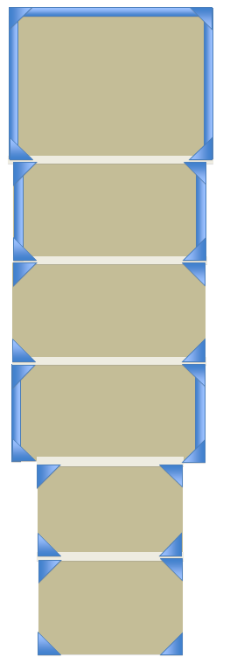
Tent grondfloor Organic V2 @ Enghien Parc
Flooring / planchers (1x 14x14 / 2x 4x26)
Sanitary unit
3x4 stage / 50 cm high
Bars
Videoscreens
‘Open’ sides
‘Closed’ sides
regie
BBQ
Castle
BBQ
Main-tent : 45x20m
Shelter/rooftent : 15x20m
Furniture : Some 30 ‘mange-debout’ & 60 poufs in main-tent / Some 30 mange-debouts in shelter-terrace

